Slide 1
Pixar Film Analysis: Patterns Behind Success
Analyzing the Relationship Between Production Elements and Film Outcomes
By Sergio Sagastume
Notes:
Welcome to my presentation on analyzing Pixar films. Today I'll explain how production elements influence a company's success, both critically and financially.

Slide 2
Project Overview
Objective:
To uncover trends and correlations between Pixar film production elements and their outcomes, including box office performance, IMDb and Rotten Tomatoes ratings, and Oscar performance.
Tools Used: Google BigQuery, SQL, Looker Studio
Notes:
This project uses data analytics to explore trends and outcomes across Pixar films, examining the relationships between team roles, release strategies, and performance.

Slide 3
The Data
Datasets Analyzed:
pixar_films.csv
academy_awards.csv
genres.csv
pixar_people.csv
Data was cleaned, loaded into BigQuery, and enhanced with calculated fields (e.g., release_year).
Notes:
I used four datasets: pixar_films, academy_awards, genres, and pixar_people. After cleaning them and uploading them to BigQuery, I created calculated fields to facilitate trend analysis.

Slide 4
Key Questions
1. What production patterns are common among Pixar's Oscar-winning films?
2. Do higher IMDb ratings predict higher box office revenue?
3. How have Pixar film ratings evolved over the years?
Notes:
These are the three key questions that guided the analysis and helped define the SQL queries and visualizations used throughout the project.

Slide 5
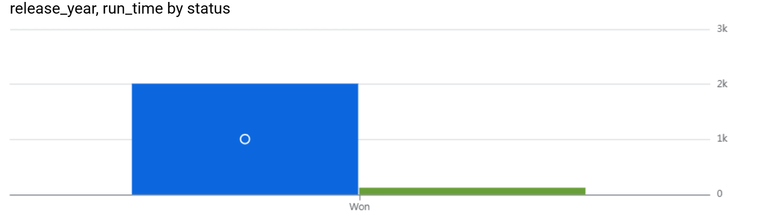
Visual 1: Oscar Wins by Year
Insight:
Most Pixar films were nominated, but only a few won. Some years, multiple awards were won, often for creative innovations.
Notes:
This bar chart shows the number of Oscars over the years. It can be seen how only a few films won awards, often during periods of creative ambition.

Slide 6
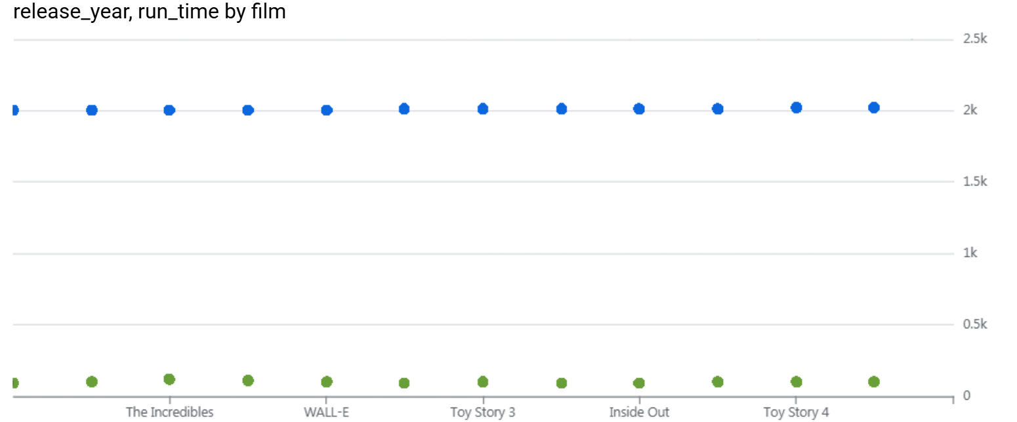
Visual 2: IMDb Ratings vs. Box Office
Insight:
High ratings don't always translate into higher revenue, highlighting the influence of other factors such as marketing, the status of the sequel, and the timing of the release.
Notes:
This scatter plot reveals that critical acclaim, as measured by IMDb ratings, doesn't always match financial performance, raising questions about marketing, timing, and audiences.

Slide 7
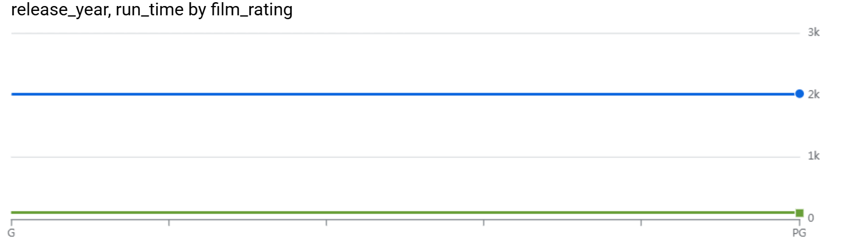
Visual 3: Film Ratings Over Time
Insight:
Shift from G to PG ratings over time indicates a deeper narrative. PG-rated films dominate recent award winners.
Notes:
This timeline shows how Pixar has shifted from mostly G-rated films to predominantly PG-rated films over the years, suggesting deeper or more emotionally complex stories.

Slide 8
Key Insights
Oscar winners often share creative teams.
PG-rated films dominate recent hits.
Critical success ≠ commercial success.
Winning films have longer runtimes and deeper themes.
Notes:
These are the main findings from the data. Creative teams and film ratings correlate with results, and PG-rated films have garnered recent critical acclaim.

Slide 9
Recommendations
Foster successful creative collaborations.
Guide themes using box office and audience trends.
Align film releases with awards seasons.
Market high-quality films more effectively.
Focus on emotional depth and PG storytelling.
Notes:
Based on the analysis, I recommend prioritizing depth of storytelling, strengthening successful creative partnerships, refining marketing strategy, and aligning releases with awards cycles.

Slide 10
Thank You / Q&A
Questions or feedback?
📧 Sergio Sagastume
🔗 GitHub: [Insert GitHub Link if needed]
Dataset Source:
Kaggle – Pixar Films 1995–2024
Notes:
Thank you for watching this presentation. If you have any questions, please feel free to contact me. The dataset is from Kaggle: Pixar Films 1995–2024.

